Slide 1
Facebook outage on 10/04
Some basics on Meta traffic architecture

Slide 2

Facebook? Meta?

Slide 3
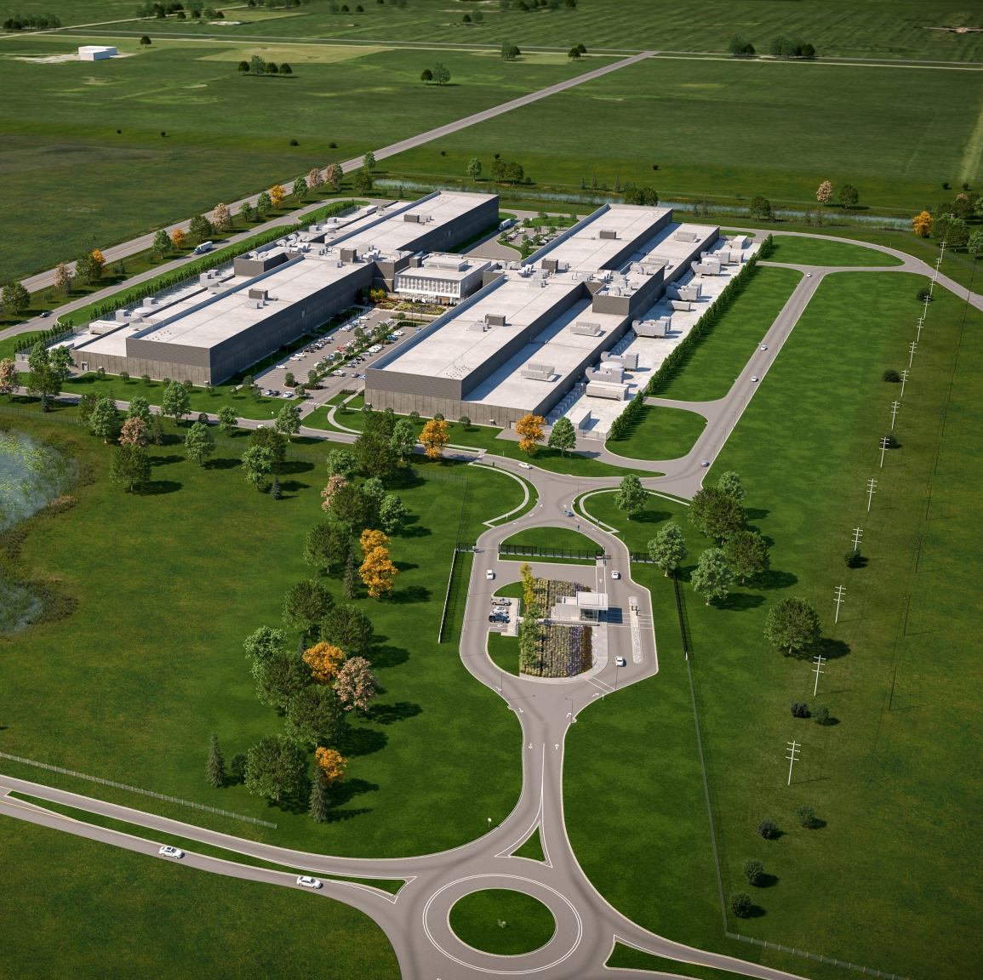
Data centers
https://datacenters.fb.com
All user data storage
Most services
Located in USA, Europe and Singapore

Slide 4
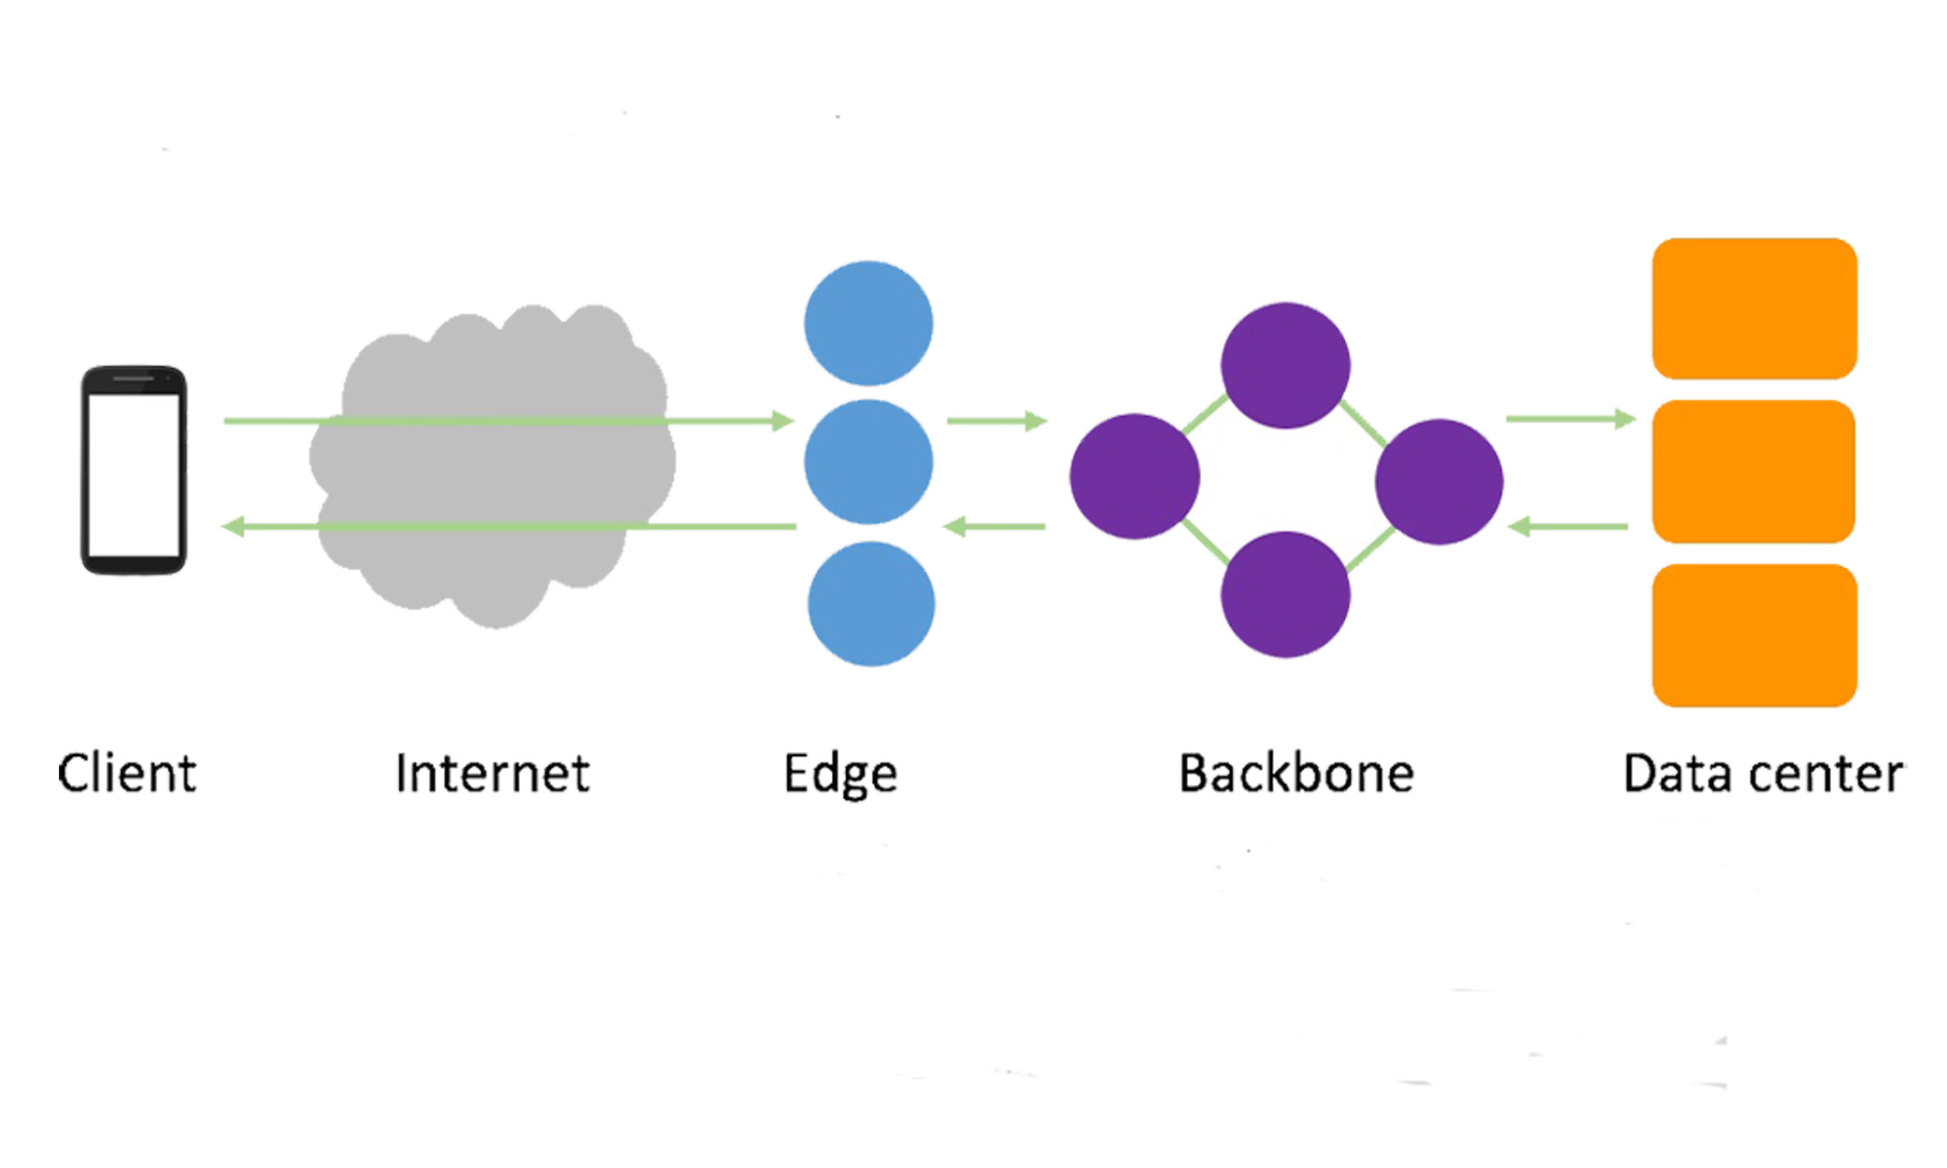
No data center in Australia, Africa or South America?
How long does it take a user in Sydney to reach his closest DC?
What if many users want to view the same hot video.
Edge POP (points of presence)
https://engineering.fb.com/2017/08/21/networking-traffic/steering-oceans-of-content-to-the-world/

Slide 5
What does an Edge do?
CDN (content delivery network)
DNS server
Peering https://engineering.fb.com/2021/05/20/networking-traffic/peering-automation/

Slide 6
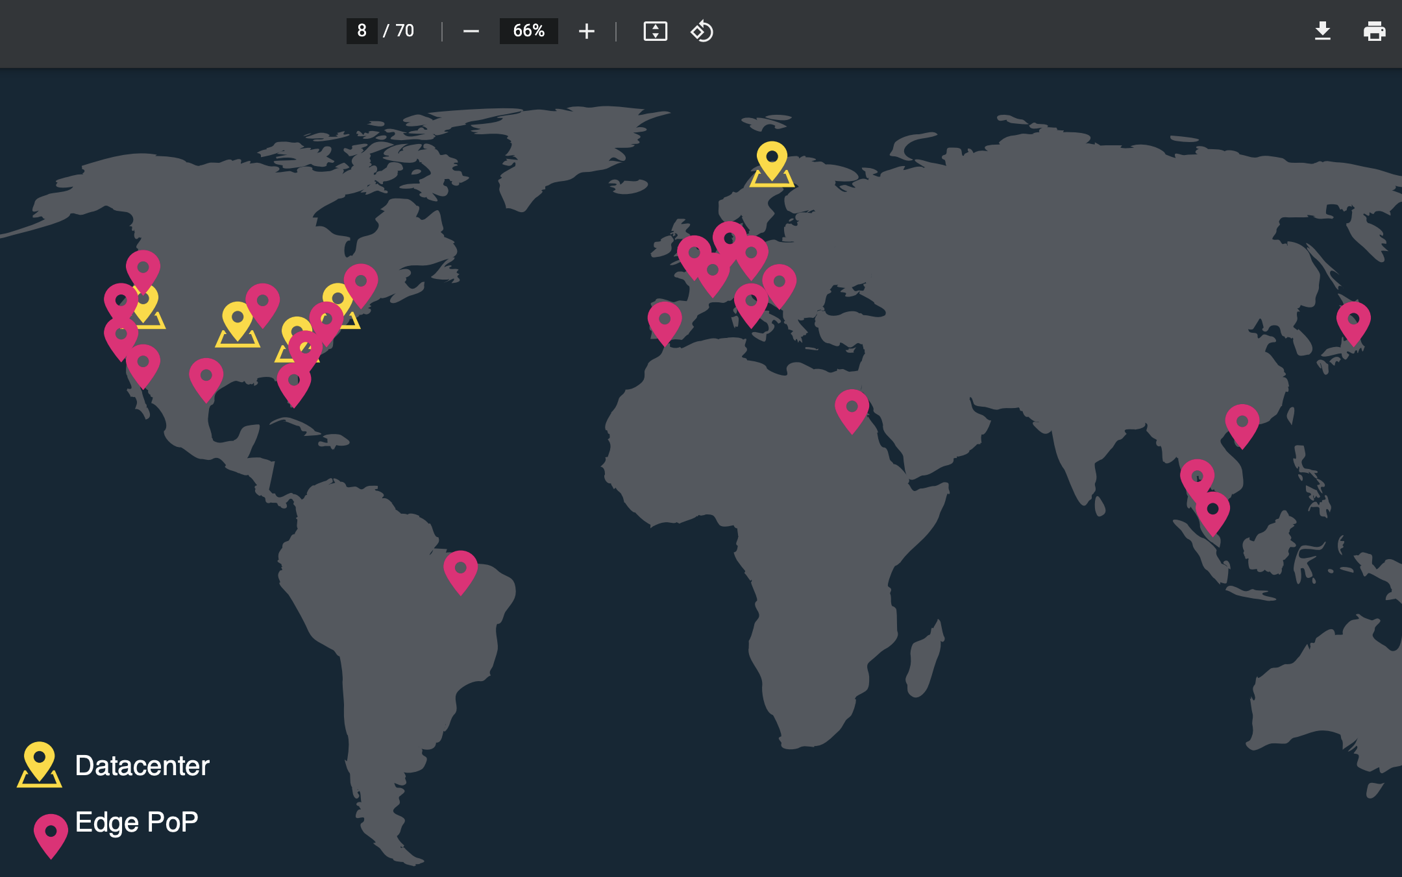
Edge locations
https://www.cs.unc.edu/xcms/wpfiles/50th-symp/Moorthy.pdf

Slide 7
Pros & cons of Edge
Pros
Faster delivery
Cons
Security & Privacy

Slide 8
How does a DNS know where to re-direct?
BGP (Border Gateway Protocol)
https://research.facebook.com/publications/running-bgp-in-data-centers-at-scale/

Slide 9
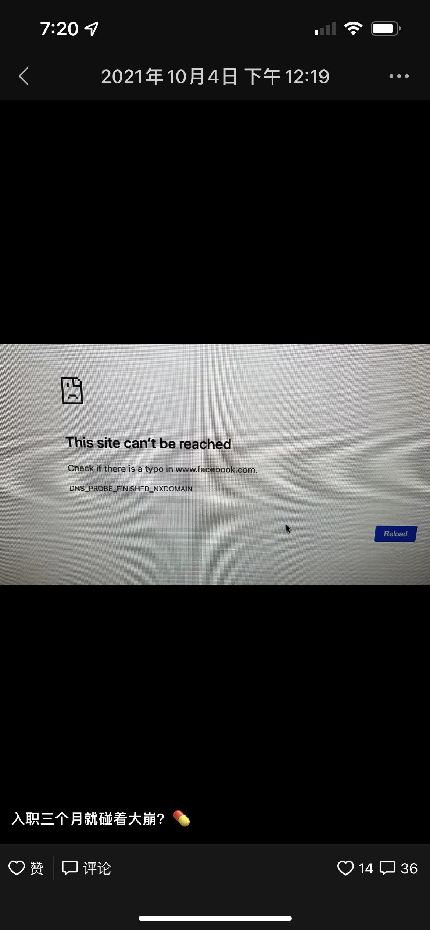
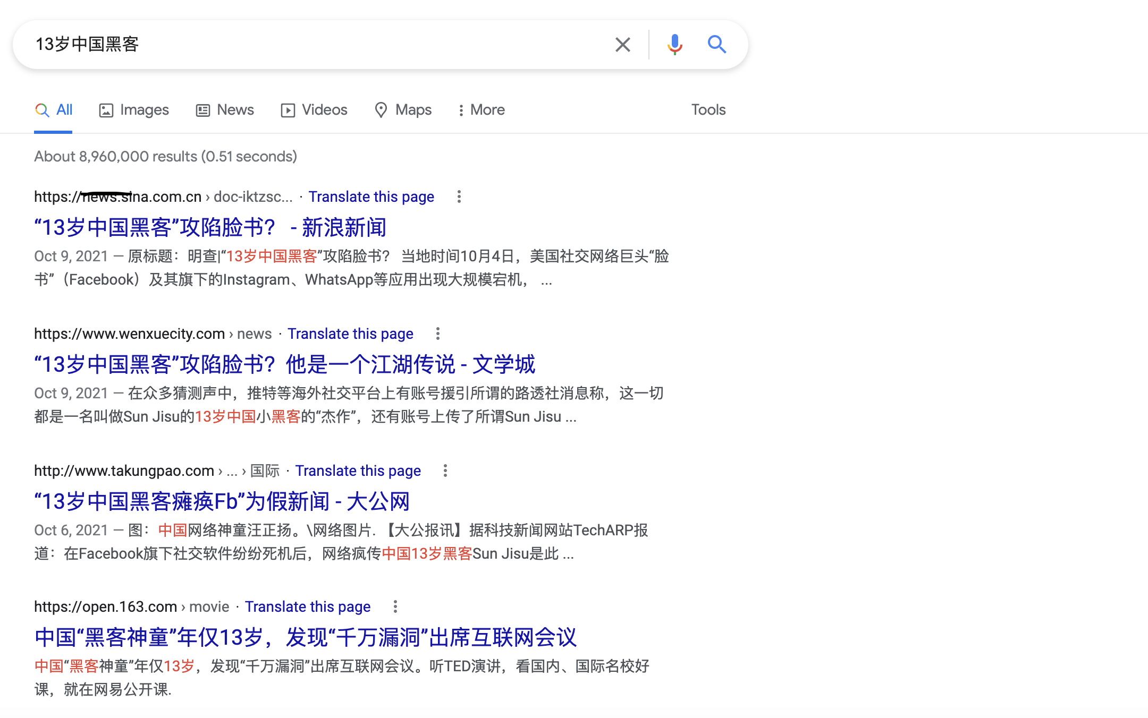
What happened to Facebook that day?
传13岁中国黑客。。。

Slide 10
Truth
https://engineering.fb.com/2021/10/05/networking-traffic/outage-details/
An engineer ran a command to drain all datacenters globally.
The protection did work due to a bug.
BGP stopped broadcasting addresses.
DNS servers don’t have directions. (That’s why we see dns errors.)
Datacenters were restarted to recover.

Slide 11
Why did it take so long to recover?
All tools were done including workchat (internal version of messenger)
It took much longer for engineers to get into the datacenters.
Could we just restart all machines at the same time?

Slide 12
Anything we learned from the outage?

